Slide 1


Applied Data Science Capstone course
Most efficient cultural holiday in Florence
by Francesca Scalesse

Slide 2
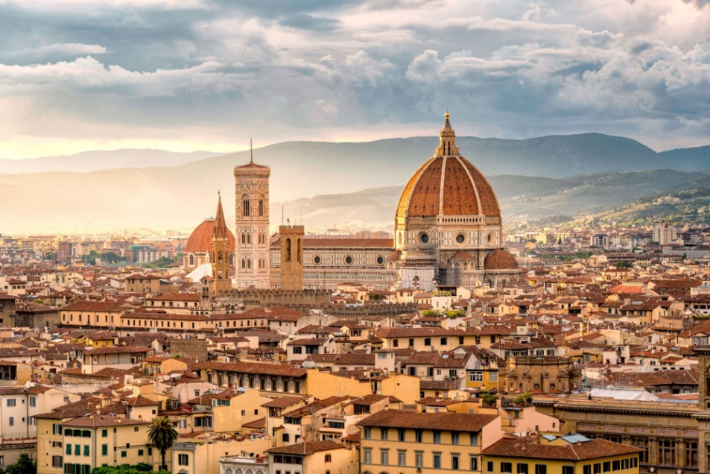
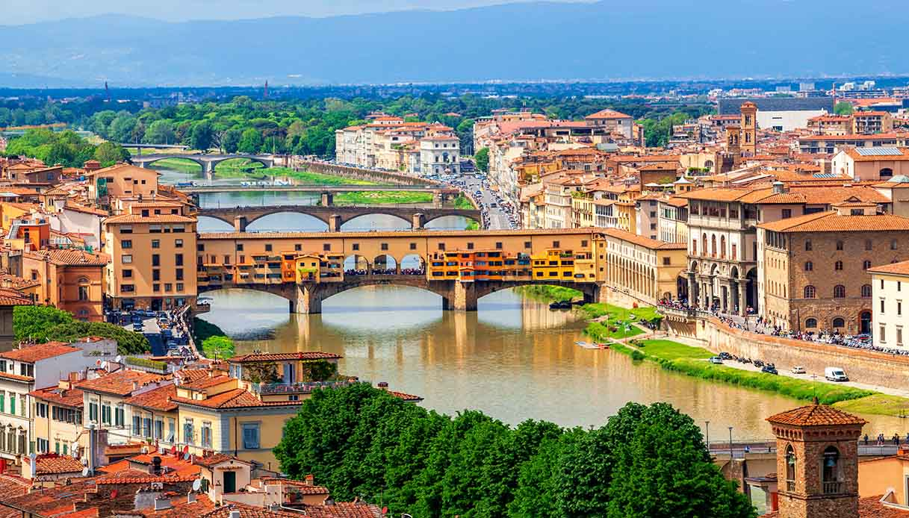
Introduction: Florence
It is an italian city, rich of history and cultural heritage sites like museums, churches...
They can be found both in the centre and in peripheral zones
You can easily visit it moving by foot
Wide possibility for people interested in cultural holidays

Slide 3
Introduction
Problem
Solution
The most amount of churches and museums are in the central zone.
Public transport cannot go in this zone because it is a pedestrian area.
Finding an hotel in a zone with the highest concentration of these sites,
in order to visit as many of them as possible during a brief holiday.

Slide 4
Data acquisition and cleaning
Museums and churches
The data are acquired separately from the website Foursquare (https://foursquare.com/)
Both data frames about churches and museums was merge in an unique data frame
Cleaned data contains 56 rows and 5 feature
Hotels
The data are acquired from the website Foursquare (https://foursquare.com/)
Cleaned data contains 30 rows and 5 feature

Slide 5
Methodology
Clustering:
K-Nearest Neighbours (KNN)
Distance calculus:
haversine formula
Quick calculation time
Simple to interpret
Versatility (useful both for regression and classification)
High accuracy
Determines the great-circle distance two points on a sphere, given their latitude and longitude
Fast computation
Easily imported by scikit library

Slide 6
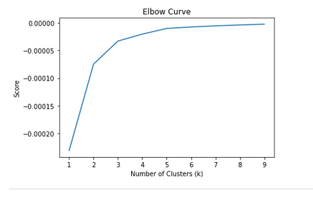
K-Nearest Neighbours: elbow curve
A method to find the best number of clusters on the data frame containing Florence’s churches and museums
K = number of clusters
K-means algorythm was applied with k = 1- 10
Observation:
The improvement is noticeably for k <= 5
For K > 5 there was not any significant changing.
Conclusion:
K = 5 resulted to be the best value.

Slide 7
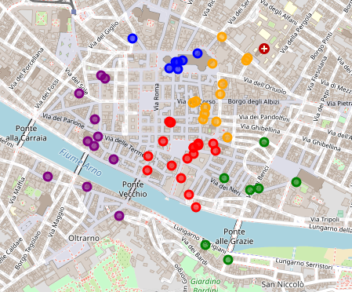
K-Nearest Neighbours: Clustering
Number of data points in the clusters
cluster 0 = 7
cluster 1 = 18
cluster 2 = 7
cluster 3 = 11
cluster 4 = 13
Algorithm parameters:
Init = “k-means++”
n_clusters = 5
n_init = 10
The cluster with the highest amount of museums or churches is the cluster 1

Slide 8
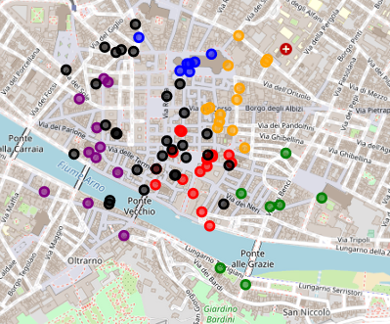
Visualization of hotels’ position
cluster 0
cluster 1
cluster 2
cluster 3
cluster 4
Hotels
There are several hotels in the cluster 1
Seven hotels in the cluster 1 will be selected to ensure they are enough close to the centroid

Slide 9
Distance between hotels and centroid
Hotel's name | Distance from the centroid (km)
Hotel Torre Guelfa (Palazzo Acciaiuoli) | 0.050652
La Casa Del garbo Hotel | 0.066505
Relais Hotel Uffizi | 0.087016
Hotel Relais Uffizi | 0.088538
Fh Hotel Calzaiuoli | 0.096272
Olga's House Hotel Florence | 0.114010
Hotel Bernini Palace | 0.129837
Distance between hotels and cluster's centroids was calculate using haversine formula
The coordinates was converted in radians
The first 7 hotels nearest to the centroids of cluster 1 was selected

Slide 10
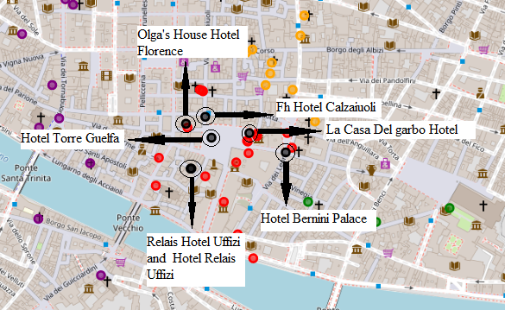
Distance between hotels and centroid
Number of data points
cluster 0 = 7
cluster 1 = 18
cluster 2 = 7
cluster 3 = 11
cluster 4 = 13
Hotels = 7
The nearest hotel to cluster's centroids is Hotel Torre Guelfa
La Casa Del garbo Hotel is another good choice because, in case of longer holiday, it is not far from the cluster 4, the second densest cluster.
Hotel's name | Distance from the centroid (km)
Hotel Torre Guelfa (Palazzo Acciaiuoli) | 0.050652
La Casa Del garbo Hotel | 0.066505

Slide 11
Conclusion
Data about churches museum and hotels were obtained from the website Foursquare.
Churches and museums were clustered using the method K- Nearest Neighbours, finding the cluster containing the highest amount of them
Hotels easily permitting to reach the most part of these cultural sites was found calculating the haversine distance between hotels and the centroid of the densest cluster.
The best choices resulted to be Hotel Torre Guelfa, the one nearest to cluster's centroid, and La Casa Del garbo Hotel because, in case of longer holiday, it is not far from the cluster 4, the second densest cluster.

Slide 12
Thank you

